Slide 1
Cloud computing
Basics of cloud computing
-Supada Hegde

Slide 2
What is Cloud Computing?
Cloud Computing is a general term used to describe a new class of network based computing that takes place over the Internet,
basically a step on from Utility Computing
a collection/group of integrated and networked hardware, software and Internet infrastructure (called a platform).
Using the Internet for communication and transport provides hardware, software and networking services to clients
These platforms hide the complexity and details of the underlying infrastructure from users and applications by providing very simple graphical interface or API (Applications Programming Interface).

Slide 3
Why Cloud
Fast Application Deployment.
Hassle free maintenance.
Better resource utilization.
Platform independent, security, scalability.

Slide 4
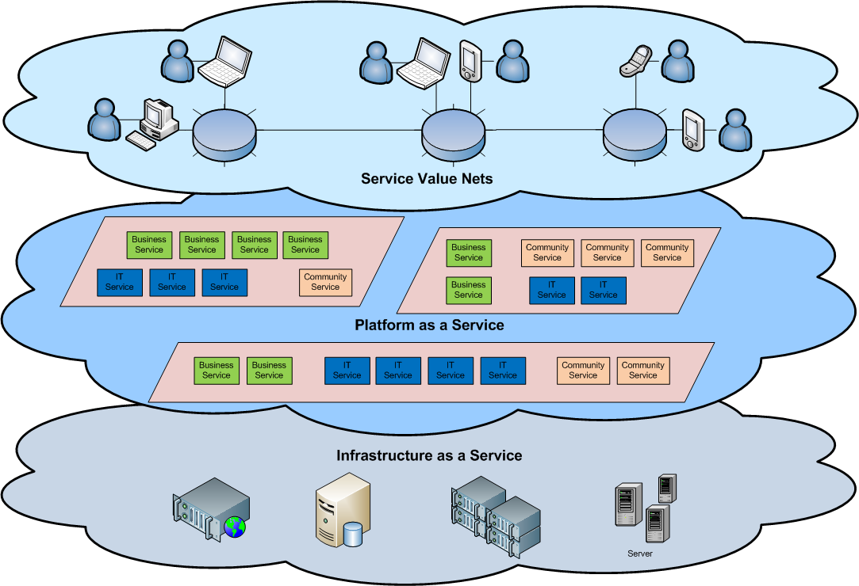
Cloud Architecture

Slide 5
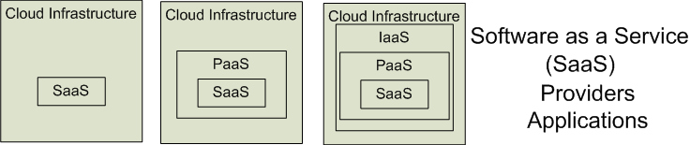
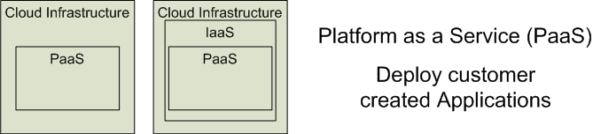
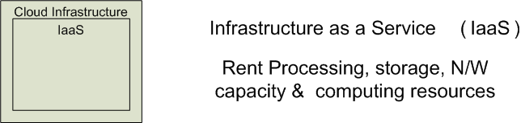
Cloud Service Models
Software as a Service (SaaS)
Platform as a Service (PaaS)
Infrastructure as a Service (IaaS)

Slide 6
Different Cloud Computing Layers‏
Application Service
(SaaS)‏
MS Live/ExchangeLabs, IBM,
Google Apps; Salesforce.com
Quicken Online, Zoho, Cisco
Google App Engine, Mosso,
Force.com, Engine Yard,
Facebook, Heroku, AWS
Application Platform
Server Platform
3Tera, EC2, SliceHost,
GoGrid, RightScale, Linode
Storage Platform
Amazon S3, Dell, Apple, ...

Slide 7
Cloud Computing Service Layers
Services
Application Focused
Application
Development
Platform
Infrastructure
Focused
Storage
Hosting

Slide 8
Software as a Service (SaaS)
SaaS is a model of software deployment where an application is hosted as a service provided to customers across the Internet.
Saas alleviates the burden of software maintenance/support
but users relinquish control over software versions and requirements.
Terms that are used in this sphere include
Platform as a Service (PaaS) and
Infrastructure as a Service (IaaS)

Slide 9
Virtualization
Virtual workspaces:
An abstraction of an execution environment that can be made dynamically available to authorized clients by using well-defined protocols,
Resource quota (e.g. CPU, memory share),
Software configuration (e.g. O/S, provided services).
Implement on Virtual Machines (VMs):
Abstraction of a physical host machine,
Hypervisor intercepts and emulates instructions from VMs, and allows management of VMs,
VMWare, Xen, etc.
Provide infrastructure API:
Plug-ins to hardware/support structures

Slide 10
Virtualization
App
App
App
OS
OS
OS
Hypervisor
Hardware
Virtualized Stack

Slide 11
Purpose and benefits of Cloud
Cloud computing enables companies and applications, which are system infrastructure dependent, to be infrastructure-less.
By using the Cloud infrastructure on “pay as used and on demand”, all of us can save in capital and operational investment!
Clients can:
Put their data on the platform instead of on their own desktop PCs and/or on their own servers.
They can put their applications on the cloud and use the servers within the cloud to do processing and data manipulations etc.

Slide 12
Cloud Storage
Several large Web companies are now exploiting the fact that they have data storage capacity that can be hired out to others.
allows data stored remotely to be temporarily cached on desktop computers, mobile phones or other Internet-linked devices.
Amazon’s Elastic Compute Cloud (EC2) and Simple Storage Solution (S3) are well known examples
Mechanical Turk

Slide 13
Advantages of Cloud Computing
Lower computer costs
Improved performance
Reduced software costs
Instant software updates
Improved document format compatibility
Unlimited storage capacity
Increased data reliability
Universal document access
Latest version availability

Slide 14
Disadvantages of Cloud Computing
Requires a constant Internet connection
Does not work well with low-speed connections
Features might be limited
Can be slow
Stored data might not be secure
Stored data can be lost

